Slide 1
PSYC100 GENERAL PSYCHOLOGY
MOTIVATION

Slide 2
Learning Outcomes
What is motivation?
Motivation theories
  Drive theory
  Instinct theory
  Arousal theory
  Expectancy-value theory
  Intrinsic-extrinsic motivation
  Achievement motivation

Slide 3
What is motivation?
Do you remember the theoretical approaches?
  Biopsychological approach
  Behaviourist approach
  Psychodynamic approach
  Humanistic approach
  Cognitive approach
  Evolutionary approach

Slide 4
What is motivation?
Motivation refers, in a general sense, to processes involved in the initiation, direction, and energization of individual behaviour …(Geen, 1995)
The study of motivation is the study of all those pushes and prods – biological, social and psychological – that defeat our laziness and move us, either eagerly or reluctantly, to action (Miller, 1962).
Rubin and McNeil (1983) identify (i) survival or physiological motives, and (ii) competence or cognitive motives. Social motives represent a third category.

Slide 5
Drive theory
Based on the concept of our body’s homeostasis.
  Homeostasis is the natural tendency to keep the body in a state of equilibrium (liver, kidneys, brain).
    E.g. thirst, hunger
Clark Hull (1943) suggested that physiological disruptions to homeostasis produce drives (internal tensions that motivate an organism to engage in behaviour to reduce this tension).

Slide 6
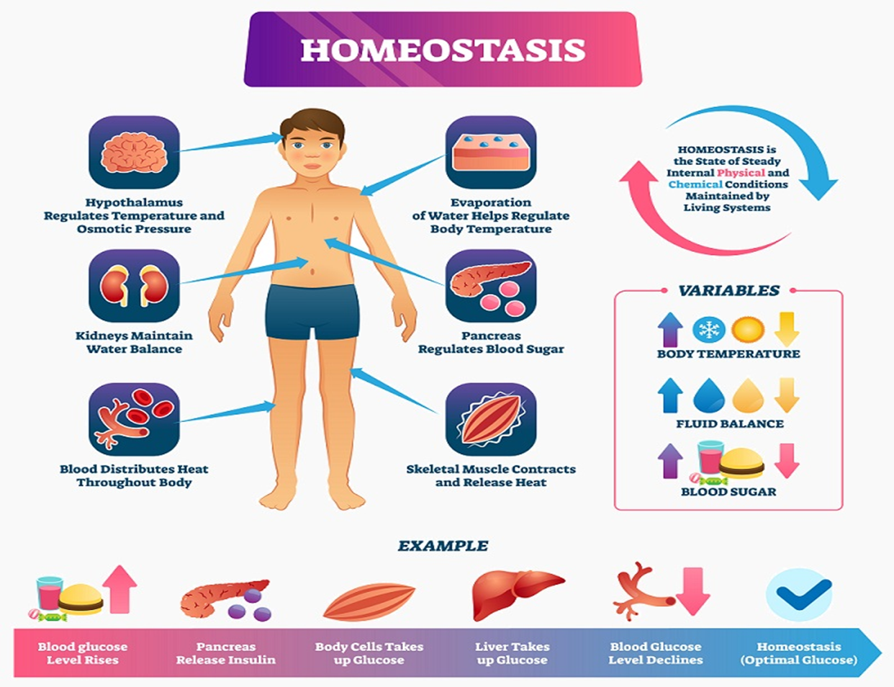

Slide 7
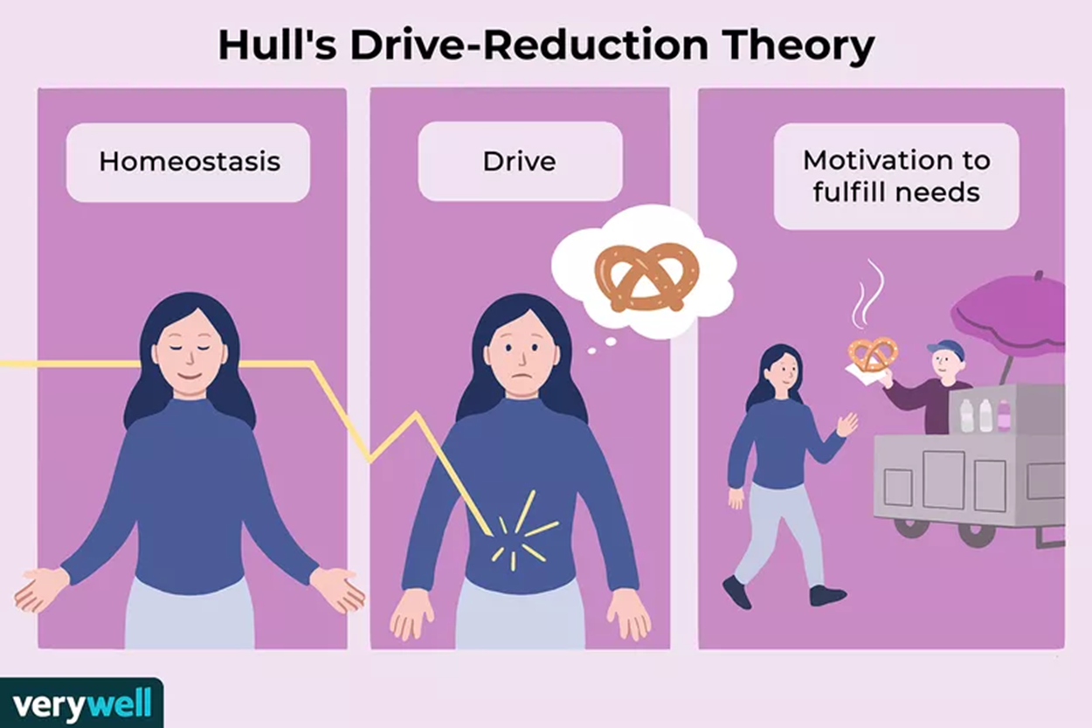

Slide 8
Evaluation
Drawbacks: dieting, for example, is contrary to the drive to eat. Plus, people often eat even when they are not really hungry.
  ● What makes you eat?
  ● Why do you get hungry?
  ● How much, if at all, do you consider social factors play a part in your eating behaviour?
  Reductionist

Slide 9
Instinct theory
Instincts are automatic, involuntary and unlearned patterns of behaviour triggered by the presence of particular stimuli
    E.g. babies are born with a unique ability that allows them to survive: they are born with the instinct to cry
    E.g. coughing, blinking
  Buss (1999) suggested that the desire to pass on our genes may provide the motivational forces for such things as love, romantic relationships, attraction and marriage.

Slide 10
Evaluation
Ignores learning and environment
It doesn't account for individual differences
Empirical Challenges: Testing instincts is hard because they're innate, making it difficult to isolate them from learned responses
Reductionist

Slide 11
Arousal theory
People take certain actions to either decrease or increase levels of arousal. When arousal levels get too low, for example, a person might watch an exciting movie or go for a jog. When arousal levels get too high, a person would probably look for ways to relax such as meditating or reading a book.
According to this theory, we are motivated to maintain an optimal level of arousal, although this level can vary based on the individual or the situation. E.g. parachute jumping
We learn what keeps our own arousal levels at the optimum level.

Slide 12
Evaluation
Neglects Emotional and Social Motivators
Empirical Testing Challenges
Reductionist

Slide 13
Why are people motivated for different reasons?

Slide 14
Expectancy-value theory
Goal-directed behavior is jointly determined by the strength of the person’s expectation that particular behaviors will lead to a goal and by the incentive value the individual places on that goal (Brehm & Self, 1989).
Motivation = expectancy x incentive value.
E.g. A college student preparing for a midterm expects to do well because they’ve consistently scored high on practice quizzes (high expectancy). They value the exam because it’s worth 30% of their grade and they aim to get into a post graduate program(high value). This motivates the student to study hard. Conversely, a student with low confidence in math (low expectancy) and no interest in the subject (low value) might skip studying for a calculus test.

Slide 15
Evaluation
Based on subjective experiences (i.e. a student might overestimate his/her skills).
External influences (i.e. a student might study hard due to financial constraints).
Overemphasis on rationality (students do not always make calculated decisions, but emotions, procrastination, or impulsivity often play a larger role in college settings).
Cultural and social variability

Slide 16
Intrinsic-extrinsic motivation
Cognitive theorists also distinguish between extrinsic motivation, performing an activity to obtain an external reward or avoid punishment, and intrinsic motivation, performing an activity for its own sake—because you find it enjoyable or challenging.
E.g. A student enrolls in a creative writing course because they love storytelling and find joy in crafting narratives, even if it’s not required for their major. The process of writing itself is rewarding. INTRINSIC
E.g. A student enrolls in a creative writing course because it’s a very easy course and he will get a good grade. EXTRINSIC

Slide 17
Evaluation
Over-Simplification of Motivation
Individual Differences: Students vary in how they respond to intrinsic vs. extrinsic motivators. Personality traits (e.g., high conscientiousness) or cultural backgrounds (e.g., collectivist cultures valuing group recognition) influence whether intrinsic or extrinsic factors are more motivating.
Contextual Factors: External pressures like financial stress can overshadow both types of motivation. A student might love a subject (intrinsic) but lack energy to engage due to part-time work demands.

Slide 18
Achievement motivation
Need for achievement
McClelland and Atkinson proposed that achieve_x0002_ment behavior can stem from a positively ori_x0002_ented motive for success and a negatively oriented motivation to avoid failure, more commonly called fear of failure (1953).
David McClelland and John Atkinson developed methods to measure achievement motivation primarily through the Thematic Apperception Test (TAT). The TAT is a projective psychological test where individuals are shown ambiguous pictures and asked to create stories about them.

Slide 19
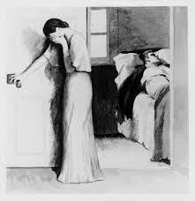
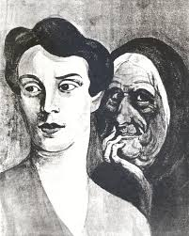
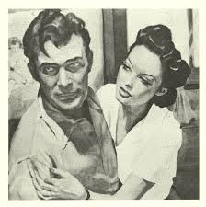
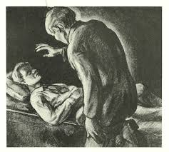

Slide 20
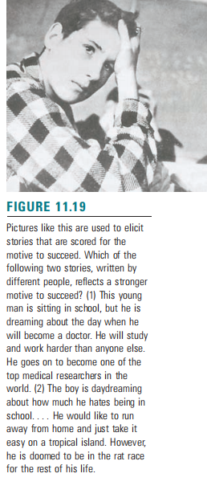

Slide 21
Evaluation
The TAT is subjective and relies on trained scorers, which can introduce variability.
It measures unconscious motives, which may not always align with explicit behaviors or self-reported goals.
Cultural differences in storytelling styles can affect the interpretation of results.

Slide 22
Lecture summary
Drive Theory: behavior is motivated by biological needs or drives, such as hunger or thirst, which create tension that individuals seek to reduce through actions.
Instinct Theory: behaviors are driven by innate, biologically determined instincts that guide actions without conscious reasoning, such as migration in animals.
Arousal Theory: individuals are motivated to maintain an optimal level of physiological or psychological arousal, seeking stimulation when under-aroused or calming activities when over-aroused.
Expectancy-Value Theory: motivation depends on the expectation of achieving a goal and the value or importance placed on that goal.
Intrinsic-Extrinsic Motivation: Intrinsic motivation drives behavior for internal rewards like personal satisfaction, while extrinsic motivation involves external rewards like money or praise.
Achievement Motivation: an individual’s drive to pursue and attain goals, often measured through thematic apperception tests for themes of success and effort.

